Slide 1
IBM University Engagement Project Submission
“Exploring the Power of Agentic AI with IBM Granite and IBM Bob”

Slide 2

Project Tile – [Write your project title here]
Domain of Project – [ like Agriculture / Education / Healthcare / … ]
Student Name | Recent Passport Photo | Email ID | Mobile number [WhatsApp]
Omkar J. Naik |  | naikomkar106@gmail.com | 8431494932

Slide 3
Problem Statement -
The Challenge
Farmers often face unpredictable weather, pest attacks, poor crop planning, and limited access to timely expert advice. Existing agricultural guidance is often fragmented and not personalized to individual farm conditions.
The Objective
Build an AI-powered Smart Farming Agent that provides personalized and timely agricultural guidance.
• Crop Advisory – Recommend crop, fertilizer, and harvesting practices.
• Weather & Irrigation – Provide weather-based irrigation advice.
• Pest & Disease Detection – Identify possible crop diseases from images.
• Agricultural RAG – Retrieve reliable crop and farming knowledge.
• Multi-Agent System –
• Crop Advisory Agent
• Weather & Irrigation Agent
• Pest & Disease Agent
• Agricultural RAG Agent
• Farm Dashboard – Display crop, weather, soil, risks, and AI recommendations.

Slide 4
Proposed Solution -
Proposed Solution: AgriSaarthi AI
AgriSaarthi AI is a multi-agent smart farming platform that combines farm data, weather information, crop images, and agricultural knowledge to provide personalized farming advice.
• AI Farm Advisor – Provides personalized recommendations based on crop, soil, location, and farm conditions.
• Multi-Agent Collaboration – Specialized agents analyze crop, weather, irrigation, and pest/disease conditions.
• RAG Knowledge System – Retrieves reliable agricultural information to support AI recommendations.
• Crop Health Analysis – Allows farmers to upload crop images for possible pest and disease identification.
• Smart Irrigation – Uses weather and soil information to suggest when to irrigate or delay irrigation.
• Farm Dashboard – Displays crop status, weather, risks, alerts, and recommended actions in one place.

Slide 5
Technology Used
• IBM Bob – AI-assisted development and project building.
• Ollama + Llama 3.2 – Local, open-source AI model for development.
• IBM watsonx.ai + Granite – Production-ready AI model integration.
• RAG + pgvector – Retrieves relevant agricultural knowledge for grounded answers.
• React + Vite – Frontend web application.
• FastAPI + Python – Backend and API development.
• PostgreSQL – Stores farmer, farm, crop, and AI data.
• Docker Compose – Runs and manages the application services.

Slide 6
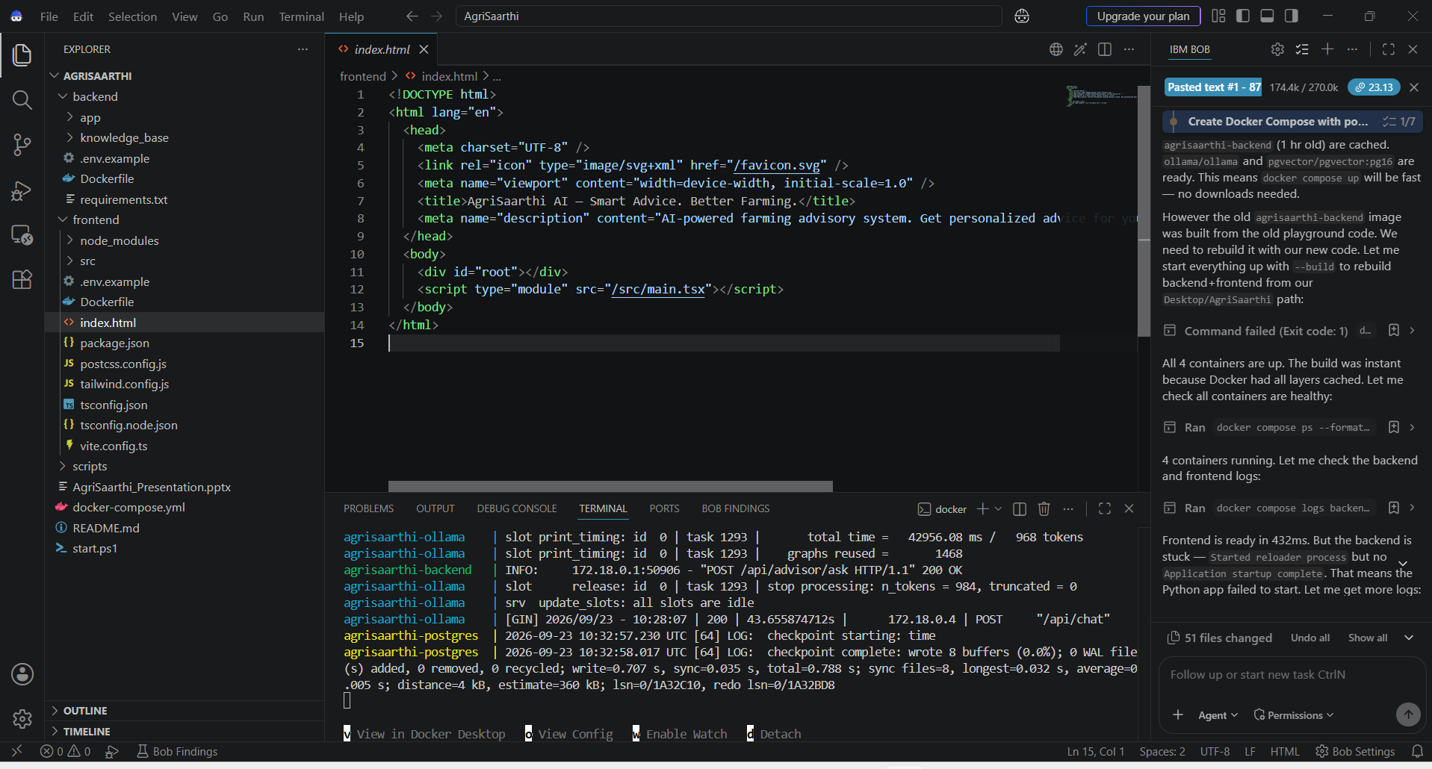
Required Files created using IBM bob -
App.py
Requirements.txt
Style.css
.env
Index.html

Slide 7
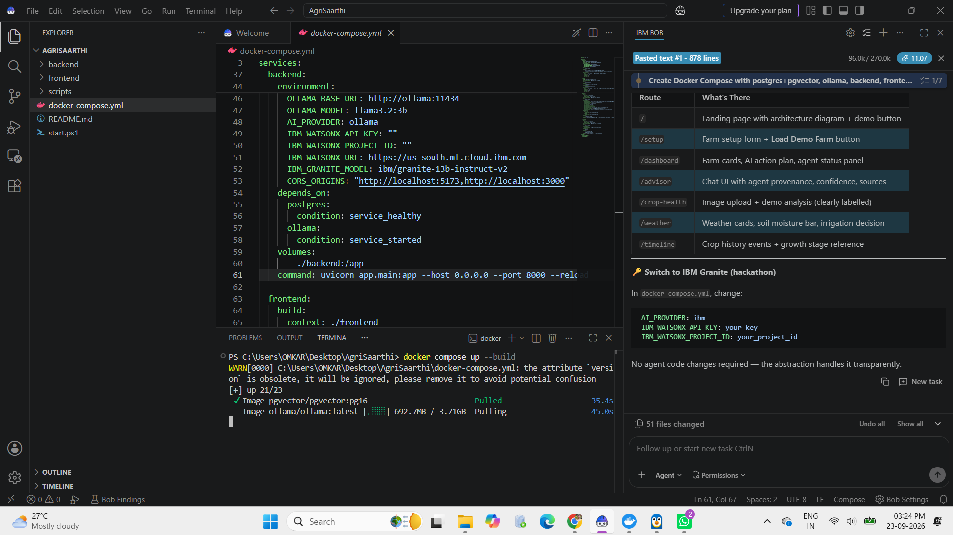
IBM Bob working Screenshots:

Slide 8
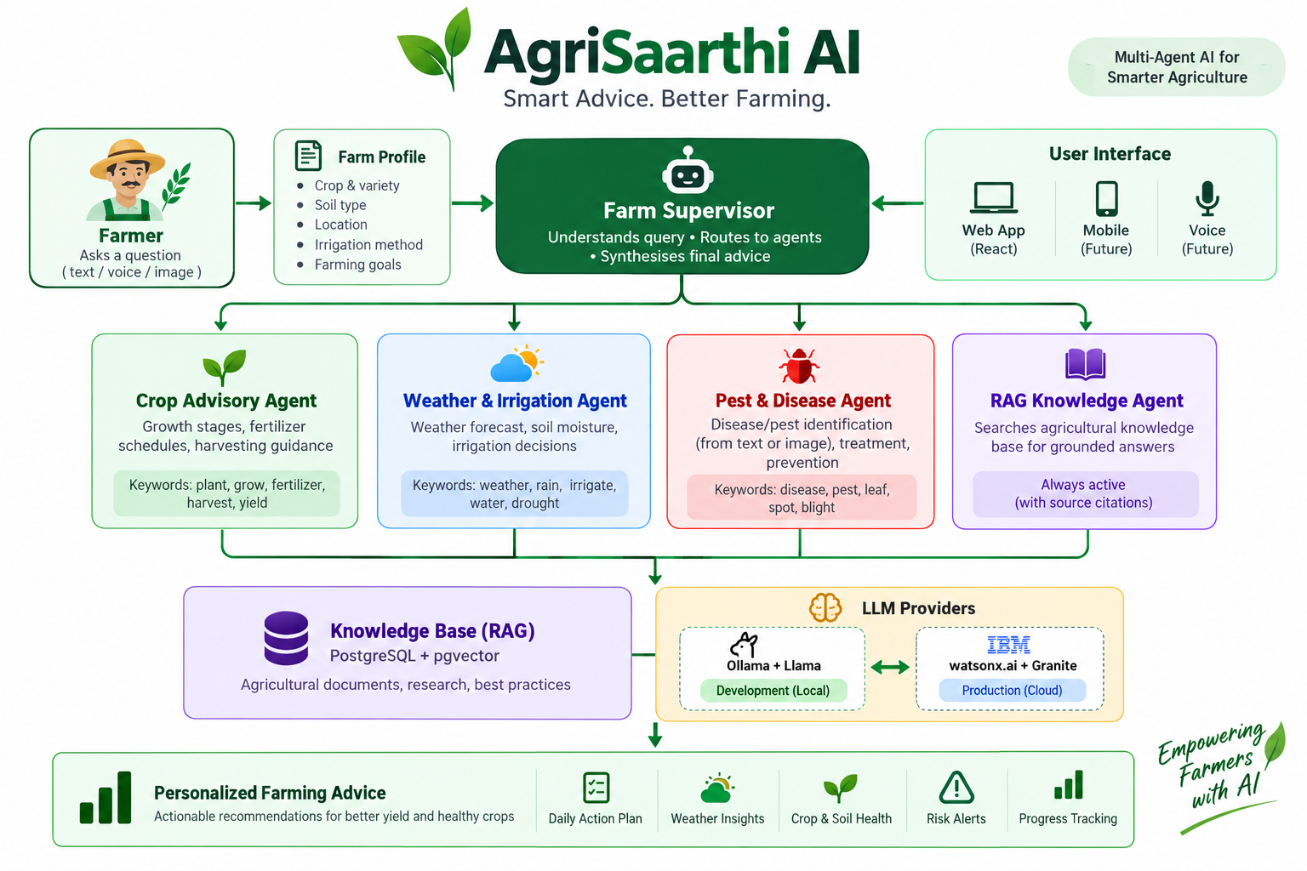
Architecture blueprint for IBM bob:

Slide 9

Role of Agentic AI in the solution
Autonomous Decision-Making – Analyzes farmer queries and determines the appropriate action.
Multi-Agent Collaboration – Coordinates specialized agents for crop, weather, pest, and agricultural knowledge.
Context-Aware Recommendations – Combines farm conditions and retrieved knowledge to generate personalized advice.
Task Orchestration – Routes each request to the relevant agent and combines their outputs.
Continuous Assistance – Provides actionable farming recommendations through an interactive AI system.
Intelligent Problem Solving – Moves beyond simple question-answering by coordinating multiple AI capabilities. AgriSaarthi_Presentation

Slide 10
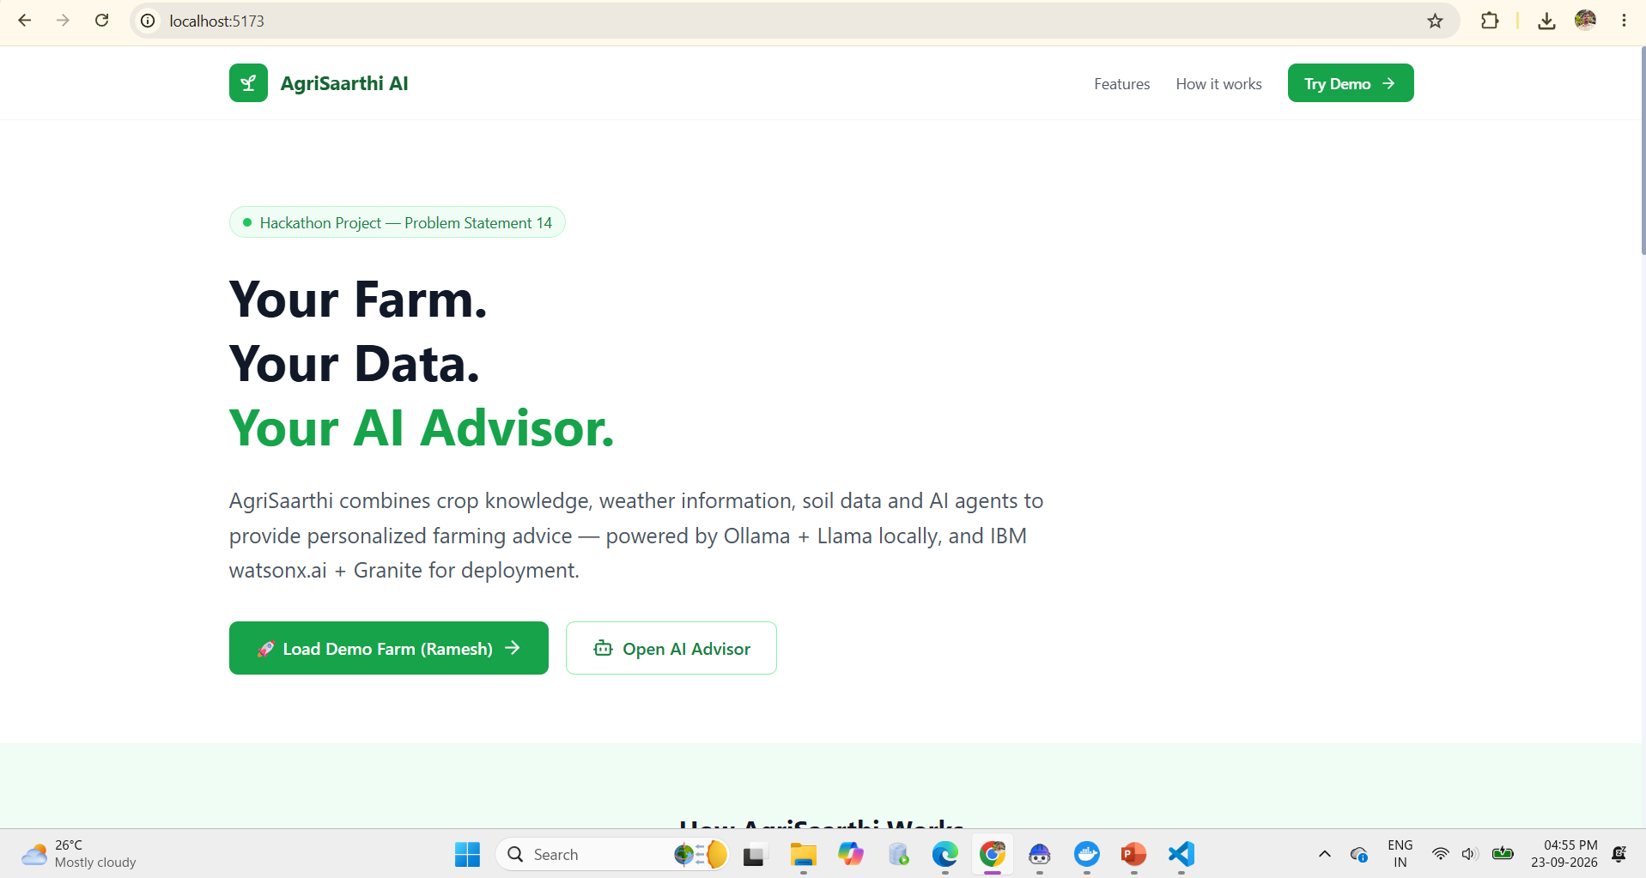
Project Output Screenshot
Please put IBM Bob output screenshots with 2-3 prompts.
You can take 2-3 more slides for each screenshot
·
·
·

Slide 11
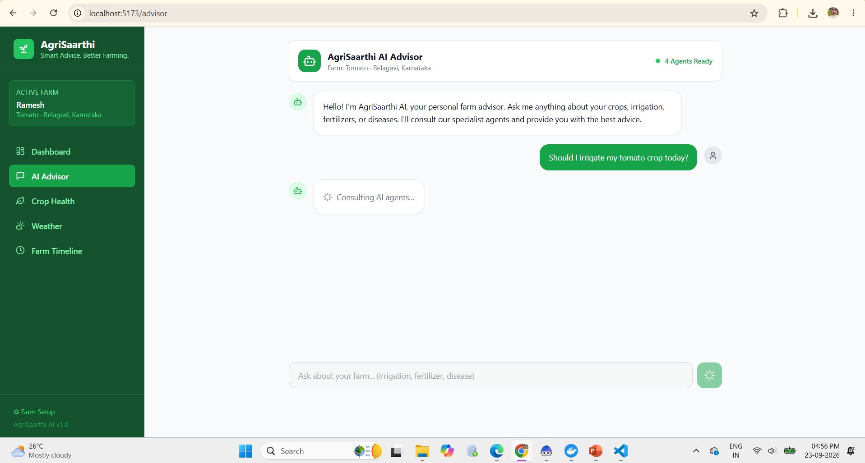
Project Output Screenshot
Please put IBM Bob output screenshots with 2-3 prompts.
You can take 2-3 more slides for each screenshot
·
·
·

Slide 12
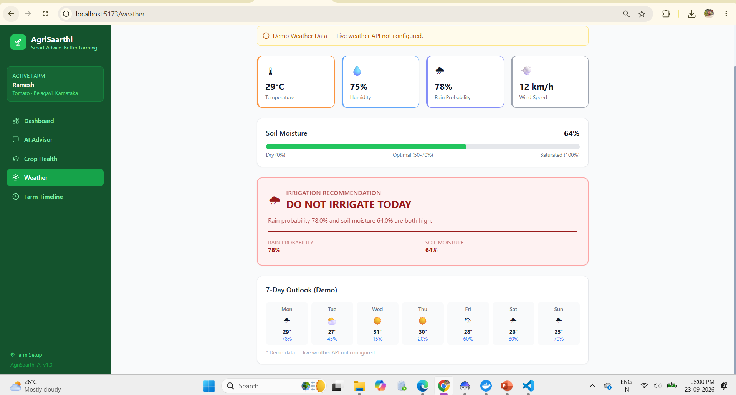
Project Output Screenshot
Please put IBM Bob output screenshots with 2-3 prompts.
You can take 2-3 more slides for each screenshot
·
·
·

Slide 13
Novelty and Uniqueness
Multi-Agent Farming System – Multiple specialized AI agents collaborate to provide comprehensive farming advice.
Personalized Recommendations – Advice is generated based on the farmer’s crop, soil, weather, and farm conditions.
RAG-Based Agricultural Knowledge – Uses a knowledge base to provide context-aware and grounded farming guidance.
Integrated Crop Health Analysis – Combines crop advisory with pest and disease identification.
Smart Irrigation Guidance – Provides irrigation recommendations using weather and soil-moisture information.
Unified Farm Dashboard – Brings crop, weather, soil, risk, and AI recommendations into one interface.
Scalable AI Architecture – Designed for integration with IBM Granite and watsonx.ai for future deployment. AgriSaarthi_Presentation

Slide 14
Git Hub Link
https://github.com/ominaik017-create/Agrisaarthi.git
·
·
·

Slide 15
Future Scope
Future Scope
Real-Time Weather Integration – Connect live weather APIs for accurate farming recommendations.
IoT-Based Monitoring – Integrate soil moisture, temperature, and humidity sensors.
Advanced Disease Detection – Improve crop disease detection using image-based AI models.
Voice-Based Farming Assistant – Provide advice through regional-language voice interaction.
Market Price Insights – Add crop price and market trend information.
Mobile Application – Extend AgriSaarthi AI to Android/mobile platforms.
IBM Granite Deployment – Deploy the system using IBM watsonx.ai and IBM Granite for scalable AI services.
·
·
·

Slide 16
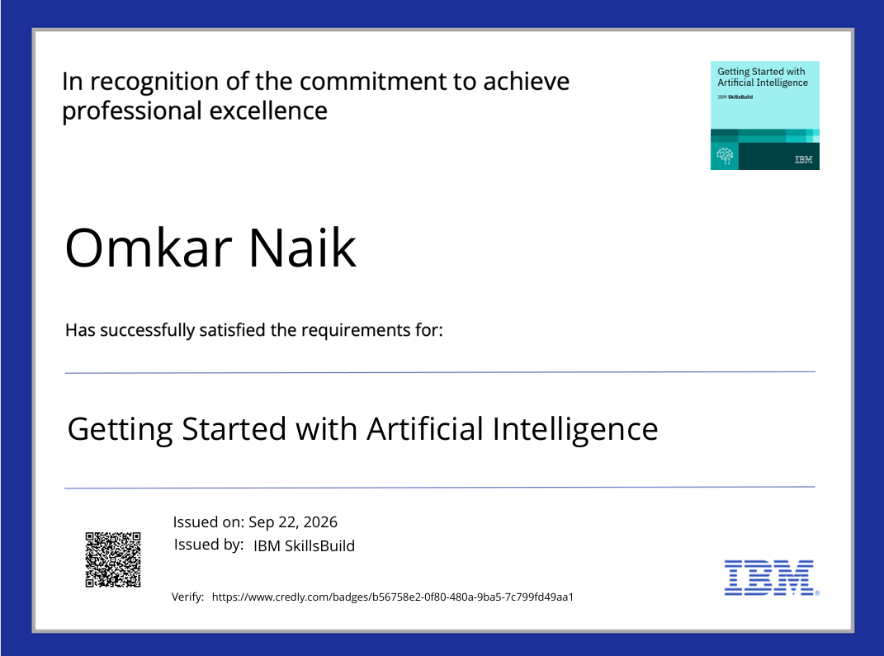
Certificates Earned:
Please add your credly certificate

Slide 17
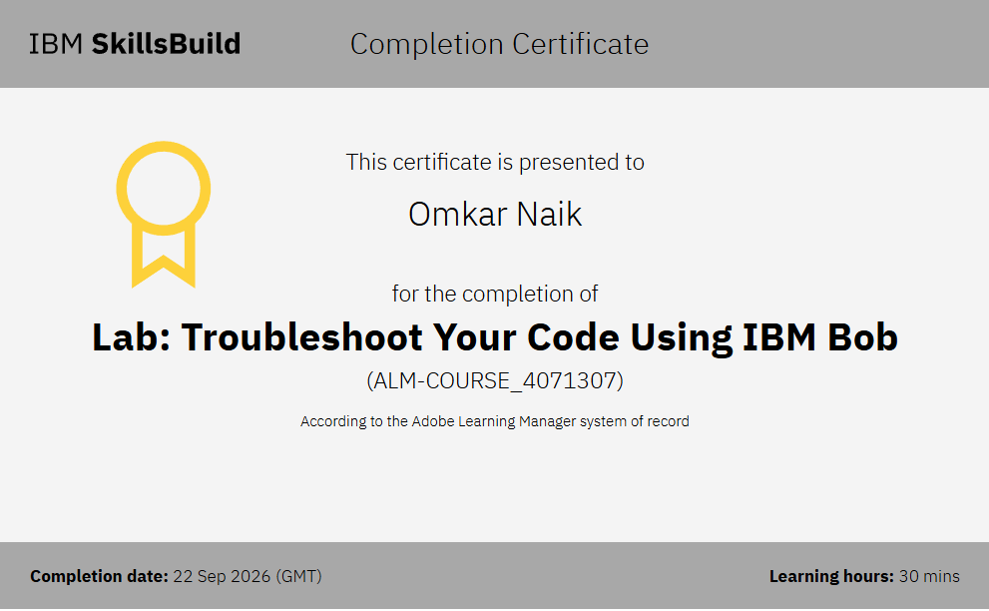
Certificates Earned:​
Add your IBM BOB Certificate

Slide 18


